Slide 1

Ch. 7. Interpersonal Relationships
(CLO-4)
EE. 4ABC. Spring 2026
Technical Communication Skills Course (SS2011)
2 Cr. Hrs.

Slide 2

Interpersonal Communication v/s Interpersonal Relationships
Interpersonal Communication: all those interactions that occur between two people to help start, build, maintain, end, or redefine our interpersonal relationships.
These are on professional grounds; mentors, peers, sub-ordinates, clients, other professionals.
Interpersonal Relationships: the sets of expectations two people have for each other based on their previous interactions (Little john & Foss, 2011).
These are on personal grounds; family, friendships, life partners.
They help satisfy our innate human need to feel connected with others.
Healthy relationships are satisfying and beneficial to all those involved.
Unhealthy ones do the opposite: dissatisfying, counterproductive, and are damaging.

Slide 3
Why engineers need this skill and understanding?
This understanding breaks down the “lone genius” narrative and myth.
That someone is tucked away in a garage, or a dark studio, or in a weird looking lab, building something brilliant all on its own. Alone and determined to win.
Steve Jobs brings Apple’s revolution. But he had partners (Steve Wozniak – the co-founder), and the real working human team.
The focus shifts to the development of an active, professional team building.
Consequently – return-on-investment (ROI) = better projects outcomes and reduced technical duty.
Notes:
The lone genius narrative is a pervasive cultural myth holding that major innovations, scientific breakthroughs, and artistic masterpieces are produced by solitary, exceptionally gifted individuals acting alone. In reality, breakthroughs are almost always the result of collaboration, accumulated knowledge, and institutional support.

Slide 4
Types of Relationships
The difference is mainly about level of closeness, trust, and sharing:
1. Acquaintance
Very limited connection
Basic interaction (e.g., greetings, small talk)
No deep personal sharing. Example: Someone in your class you say “hello” but don’t really know
2. Friend
Moderate closeness
You spend time together and share some personal thoughts
Trust is present, but not very deep. Example: A friend you hang out with and talk about daily life.
3. Intimate Relationship
Deep emotional closeness.
High level of trust and openness
Share personal feelings, fears, and private matters
Strong support and understanding.
Notes:
Example: A best friend or partner you trust with your deepest thoughts.

Slide 5
Disclosure in Relationship Life Cycles
Disclosure in relationship life cycles refers to the process of sharing personal information, thoughts, and feelings with another person. It usually increases as the relationship develops, helping build trust and intimacy between individuals. However, the level of disclosure depends on comfort, trust, and the stage of the relationship.

Slide 6
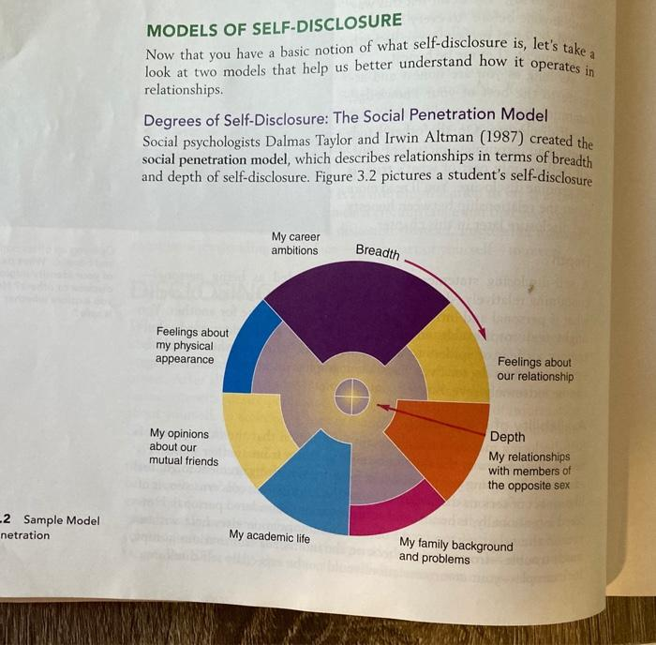
Social Penetration Theory, proposed by Irwin Altman and Dalmas Taylor, explains how relationships develop through gradual self-disclosure. As people interact, they move from superficial topics to deeper, more personal information. This process increases intimacy and strengthens the relationship over time.
Social Penetration explains that not all self-disclosure is the same—some information is more personal than others. Irwin Altman and Dalmas Taylor described it using two ideas: breadth (range of topics discussed) and depth (how personal or intimate the information is). In the beginning, people talk about general topics like family or studies, but as the relationship grows, they discuss more subjects and share deeper feelings. Over time, conversations become more personal, moving from simple facts to opinions, emotions, and meaningful life experiences.

Slide 7
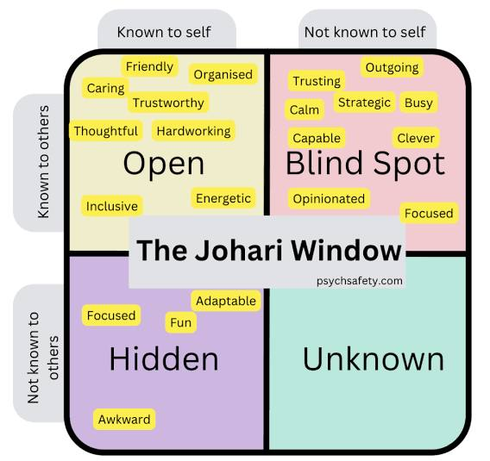
Johari Window
One way to understand the nature of disclosure and feedback in interpersonal relationships is through the Johari window. The Johari window, named after its two originators, Joe Luft and Harry Ingham (1970), consists of four panes that comprise all information about you. You and your partner each know some (but not all) of this information.
The Johari Window is a model used to understand self-awareness and communication in relationships. It has four areas:
open (known to self and others),
blind (unknown to self but known to others),
hidden (known to self but not others), and
unknown (unknown to both).
It shows how self-disclosure and feedback help expand the open area. This improves trust, understanding, and effective communication in relationships.

Slide 8

Stages of Relationships:
Beginning and Developing Relations
  Relationships begin and are built through initial sharing of mutually interested information.
  Uncertainties are reduced and better disclosure and feedback are shared.
  Can be face-to-face or online.
  Psychological trust is built and more disclosure is done.

Slide 9
Stages of Relationships (Cont’d):
2. Maintaining Relationships:
Relationships strategies are used to keep a relationship going smoothly and satisfactorily (Dindia, 2009).
Socially supportive behaviors: celebrations, gift exchanges, being polite, praising, help offerings, small sacrifices, things sharing, showing affection, …
More and frequent time is spent.
Minor mistakes are overlooked to save from hurt.

Slide 10
Stages of Relationships (Cont’d):
3. Declining and Dissolving Relationships
  When one or both partners fail to engage in sustained relationships, the relationship begins to fall apart and finally come to an end. This is through four stages:
    Circumscribing: communication decreases in both quality and quantity.
    Stagnation: emotions and enthusiasm start fading out.
    Avoiding: stagnation becomes too painful so distances increase.
    Terminating: it ends when felt there’s no worth in keeping it.

Slide 11
Role of Technology in Relationships
The internet has changed the way we build, manage, and sustained relationships.
The social media has given the freedom of speech, time, and space.
Our use of many different mediums to maintain our relationships is known as “media multiplexity”.
Technology is also used to disengage from relationships – fewer mails, calls, texts, …
Global interactions have created complex communicative communities and diverse ranges of relationships; ranging from constructive projects to crime zones.
Research suggests that young adults tend to “break up” using technology rather than having a face-to-face conversation …. (Gershon, 2010).

Slide 12
Relational Dialects
The relational dialects are the “tug-of-war” between opposing needs. There are three competing psychological tensions that exist in relationships.
Autonomy vs. Connection: “I need space to work.” vs. “We need to sync. for this project. ”
Openness vs. Closeness: “Sharing data/feelings.” vs. “Privacy.”
Predictability vs. Novelty: “Routine vs. Innovation.”
Notes:
1. Autonomy vs. Connection
Autonomy (independence):
“I’ll finish my part of the project on my own and update you later.”
Connection (collaboration):
“Let’s have a quick meeting to make sure we’re on the same page before we continue.”
2. Openness vs. Closeness
Openness (sharing):
“I’m feeling stressed about this deadline, and I think I need help.”
Closeness (privacy):
“I’d prefer to keep my personal concerns to myself and focus on the work.”
3. Predictability vs. Novelty
Predictability (routine):
“Let’s follow the same process we used last time—it worked well.”
Novelty (change/innovation):
“Why don’t we try a new approach this time to see if we can get better results?”

Slide 13

Managing Dialectical Tensions:
– providing for opposing needs
Temporal Selection: Choosing one desire for other for the time being.
Temporal Segmentation: Being open at home (having discussions), closed at work (applying restraint).
Neutralization: Compromising between the desires of one person and the other person. Finding a middle ground.
Reframing: Changing the perception about the opposing desires so they no longer seem so contradictory. The balance shifts more towards similarities rather than differences.

Slide 14
Analyze and Discuss the following Case:
Scenario: A senior engineer wants a strict hierarchy in the organization; a junior wants an open-door policy.
The Question:
How do they manage the Openness vs. Closedness tension?

Slide 15
They manage the tension by blending openness with boundaries, not choosing one over the other:
“Be open where it helps collaboration and closed where it protects structure and clarity.”
1. Agree on “Selective Openness”
They don’t have to choose one extreme.
Keep core decisions and sensitive issues (e.g., salaries, high-level strategy) more closed.
Allow general discussions, ideas, and feedback to be more open. Example:
The senior engineer keeps decision authority clear but allows team members to share ideas before decisions are finalized.
2. Create Structured Open Channels
Instead of a fully open-door policy all the time:
Set specific times or forums for openness (e.g., weekly Q&A, feedback sessions).
Maintain hierarchy outside those spaces. Example:
“Every Friday, anyone can drop in to discuss ideas or concerns.

Slide 16
3. Clarify Boundaries
Define what can and cannot be openly discussed.
This reduces confusion and protects authority where needed. Example:
“Project ideas are open for discussion, but final deadlines and assignments are decided by leads.”
4. Use Layered Communication
Combine both approaches:
Junior team members can approach team leads first (semi-open system).
Escalation to senior engineers is possible when needed. Example:
A junior shares ideas with their lead, who brings them to senior meetings.
5. Build Trust Gradually
As trust increases:
The senior engineer may become more open.
The junior learns when discretion is necessary.

Slide 17
References
https://thecitizen.com/2025/04/24/the-myth-of-the-lone-genius/
Bovee & Thill. (2016) Business Communication Today 13th Ed. (Prentice-Hall)
Kathleen S. Verderber. Communicate (13th Ed.)

Slide 18
Ch. 8. Interpersonal Communication
Providing Emotional Support, Managing Privacy and Disclosure, Negotiating Conflict, Managing Inter-personal conflict.
CLO – 04:
Identify workplace conflict and develop resolution strategies
EE Communication Skills (SS-2010) Spring 2026
Wk. 10.2

Slide 19
Learning Objectives (CLO - 04)
Describe Characteristics of Comforting Messages
Apply Disclosure and Privacy Strategies in Relationships
Inspect People Negotiating Needs, Wants, and Preferences
Manage Conflict in Relationships
Estimate Collaborative Approach to Conflicts
Activity #9 (10 marks) (CLO – 04)
Please Note: Points 2 and 3 are for your self-reading in the textbook. Points 4 and 5 are discussed in the upcoming slides.

Slide 20
1. Characteristics of Comforting Messages
Humans do need emotional support and comfort to feel secure, heal, and to revitalize.
Comforting is helping others feel better about themselves, their behavior or their situation by creating a safe space to express their thoughts and feelings.
Comfort providers feel enhanced self-esteem and improved relationships with the receivers.
Per research, both men and women value emotional support from their relationship partners.
Providing emotional support gets valued across cultural and co-cultural groups.

Slide 21
Comforting Guidelines
Clarify supportive intentions: tell clearly your motive(s) to provide support.
Protect others from feeling embarrassed, challenged, or hurting someone’s self-image.
Focus your comforting message on the other person’s needs and perspectives.
Reframe the situation by offering ideas, observations, or explanations through a different perspective.
Give advice by providing relevant suggestions to resolve a problem or a situation.

Slide 22
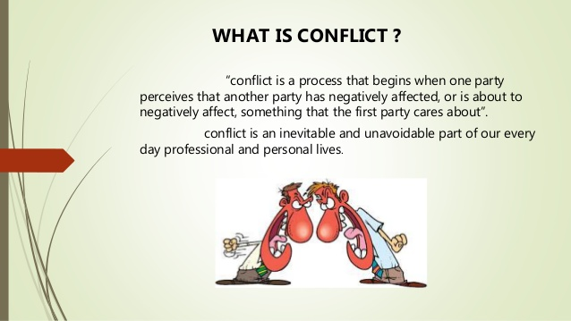

Slide 23
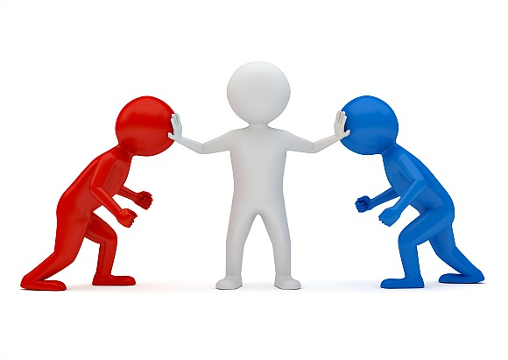
4. What is Conflict?
An expressed struggle between at least two interdependent parties who perceive incompatible goals, scarce resources, and interference from the other party in achieving their goals

Slide 24
Managing Conflict in Relationships
All relationships inevitably face/ experience conflict
Avoiding a conflict is a good strategy, but fails often
High performance teams view conflict as healthy and productive
Viewing of conflicts is different in different cultures
There are five styles to tackle/ manage conflict

Slide 25
Characteristics of Conflict
At least two people are required (interpersonal)
Involves a struggle/ incompatibility/ perceived differences among goals/ values/ desires/ perceptions
An action (without action, a conflict is latent)
Power/ attempts to influence (otherwise, it’ll be just a disagreement)

Slide 26
Views of Conflict
Traditional: all conflicts are harmful – must be avoided
Human Relational: conflict is a natural and inevitable outcome in any group
Integrationist: conflict is a positive and an essential component for a team to perform effectively
Functionalist: works towards the goals of an organization/ group
  Constructive, increases info/ ideas, innovative, reduces stagnation
Dysfunctional: blocks an organization to attain goals
  Destructive, reduces trust, reduces info, poor decisions, stressful, low tolerance

Slide 27
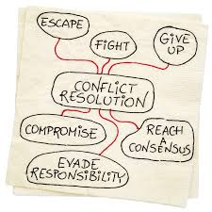
Conflict Management
‘the opportunity to improve situations and strengthen relationships’

Slide 28
The Five Styles of Conflict Management
Withdraw (Avoid)
Accommodate
Force (Compete)
Compromise
Collaborate

Slide 29
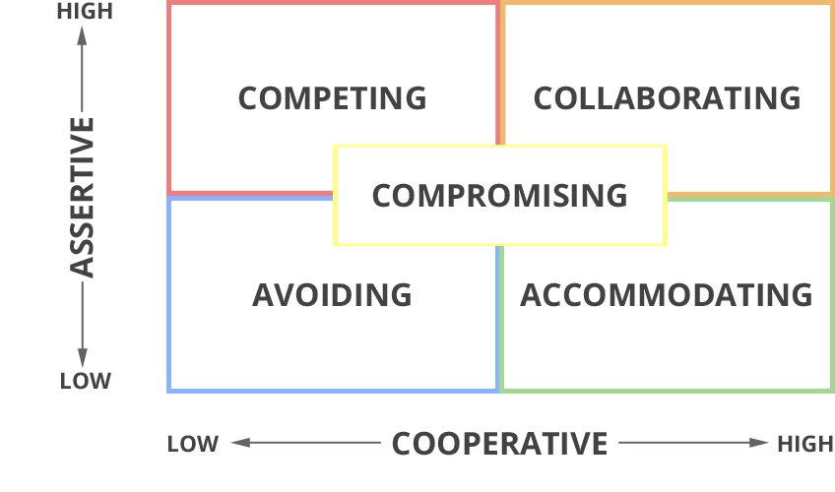

Slide 30
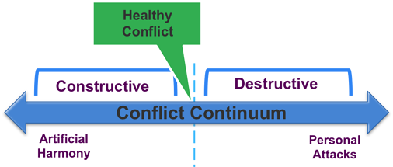
Conflict Continuum – In Other Words:
‘I win, you lose’ (Compete)
‘I lose or give in’ (Accommodate)
‘We both get something’ (Compromise)
‘We both WIN’ (Collaborate)

Slide 31
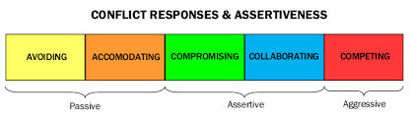
Conflict and the Associated Behaviour
Notes:
1. Passive Behavior
Passive people avoid expressing their opinions or needs to prevent conflict. This can lead to frustration and resentment because their concerns remain unspoken.
2. Assertive Behavior
Assertive people express their thoughts, feelings, and needs clearly while respecting others. This approach encourages healthy communication and problem-solving.
3. Aggressive Behavior
Aggressive people express their opinions or needs in a way that violates or disrespects others. This often creates tension, resentment, and escalates conflicts.

Slide 32
5. Estimate Collaborative Approach to Conflicts - Guidelines
Identify the problem and own it as your own – seek appropriate solutions
Describe the problem in terms of behaviour, consequences, and feelings
Don’t evaluate the other person’s motives – refrain from blaming/ accusing
Find common ground – a resolution could start off
Mentally rehearse so you can state your request briefly
Disengage – put a mental shield and avoid defensive response
Respond empathically and with genuine interest and concern
Paraphrase your understanding of the problem – ask Qs to clarify
Ask the other person to suggest alternative solutions
Individuals should understand their personal triggers
Groups should consider the dynamics/ factors that may raise conflicts

Slide 33
Practice Activity : Individual. In-Class submission.
Prep. Time: 15 minutes
10 marks. CLO – 02
Conflict Management
Instructions: Recall and briefly describe a conflict situation that you faced. Keeping in mind the content that you learnt about conflict and conflict management, elaborate the following points:
How did you react/ respond? (i.e., which approach did you use?)
What was the behaviour of the other party?
How was the conflict resolved?
What was the lesson learnt?
Refer to CLO-02 Rubric to scale your learning. Up to 2.5 marks/point

Slide 34
Activity 2
Scenario: Interrupting During Group Work
During a group discussion for a class project, Riya is explaining her idea for the presentation. Sam keeps interrupting, insisting his approach is better and talking over her. Riya feels frustrated and ignored, while Sam thinks he’s just being helpful. The group now feels tense, and the discussion is not progressing smoothly.
Task for students:
Identify the conflict.
Rewrite the blameful statements into I-statements.
Suggest ways Riya and Sam could communicate effectively to resolve the tension.

Slide 35
Answers
1. Identify the Conflict
The conflict arises because Sam keeps interrupting Riya, making her feel frustrated and ignored.
There is a communication clash—Riya wants to share her ideas, and Sam is dominating the discussion.
2. Rewrite Blameful Statements into I-Statements
Instead of “You never listen to me!” → “I feel frustrated when I’m interrupted because I want to share my ideas fully.”
Instead of “You’re always taking over the discussion!” → “I feel overlooked when my ideas aren’t heard, and I’d like a chance to speak.”
3. Ways to Communicate Effectively
Sam could pause and listen fully before responding.
Riya could politely ask for a turn: “Can I finish my idea, then we can discuss yours?”
The group could set ground rules for discussion, like taking turns or raising hands.
Both can acknowledge each other’s contributions and work toward a combined solution.

Slide 36
References
1. Bovee & Thill. (2016) Business Communication Today 13th Ed. (Prentice-Hall)
2. Kathleen S. Verderber. Communicate (13th Ed.)

